Slide 1
2023 COC NOFO WEBINAR
Welcome!
Please type your name and organization in the chat box.
This webinar will be recorded and will be posted at kthomelessalliance.org
Please type your questions into the chat. We’ll answer as many as we can today and will post a Q&A at kthomelessalliance.org if there are any we don’t answer on this call.

Slide 2
Agenda
Opening remarks
NOFO overview
Timeline
Q & A
Closing remarks

Slide 3
1) Maximize use of mainstream benefits
Coordinate & enroll participants in healthcare
Help participants understand services
Secure funding for services
2) Work to remove barriers to local resources
Prioritize those most in need
Participate in:
No Wrong Door
Coordinated Entry
Vulnerability Assessment
LOCAL FUNDING PRIORITIES

Slide 4
HUD CoC Policy Priorities
The five goals of the FY 2022-2026 Strategic Plan present the core vision of what we hope to
accomplish, the strategies to accomplish those objectives, and the indicators of success.
Strategic Goal 1: Support Underserved Communities
Strategic Goal 2: Ensure Access to and Increase the Production of Affordable Housing
Strategic Goal 3: Promote Homeownership
Strategic Goal 4: Advance Sustainable Communities
Strategic Goal 5: Strengthen HUD’s Internal Capacity

Slide 5
KTCOC ESTIMATED FUNDING AMOUNTS
Estimated ARD | Tier 1 | CoC Bonus | DV Bonus
$2,603,737 | $2,421,475 | $205,558 | $293,654
Tier I is equal to 95% of combined ARD amounts (Annual Renewal Demand)
Tier II is the difference between Tier I and the maximum amount a CoC can apply for
Additional potential funding includes:
PPRN $332,803 for any type of new project or expansion projects
CoC Planning $146,827

Slide 6
WHAT’S NEW THIS YEAR?
Affirmatively Furthering Fair Housing
https://www.hud.gov/affh
IN TEN WORDS, WHY IS AFFH IMPORTANT?
IT IS A CRITICAL TOOL AGAINST HOUSING DISCRIMINATION AND
SEGREGATION. You will be required to tell how your organization and project do this.
Certification of Consistency with the Consolidated Plan
This year each project will be required to get your own! HUD FORM 2991
City of Hanford: Sandra Lerma: slerma@cityofhandfordca.com
City of Visalia: Margie Perez: Margie.perez@visalia.city
City of Porterville: Claudia Calderon: ccalderon@ci.porterville.ca.us
City of Tulare: Alexis Costales: acostales@tulare.ca.gov

Slide 7
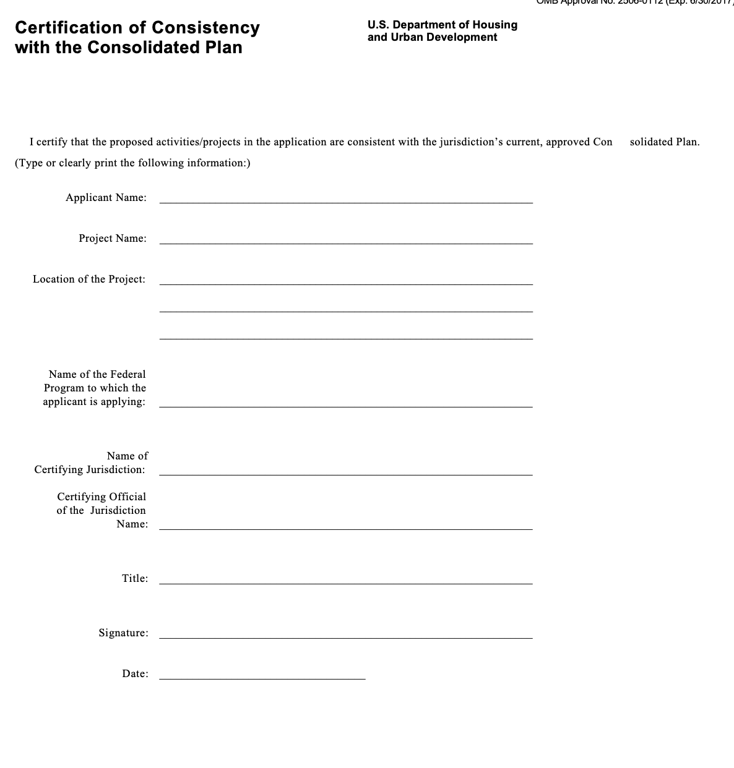

Slide 8
MORE NEW CHANGES
DV-BASED REVISED DEFINITION OF HOMELESSNESS
DOMESTIC VIOLENCE AND OTHER DANGEROUS OR LIFE-THREATENING CONDITIONS
This means individuals fleeing or attempting to flee due to domestic violence no longer have to be classified as chronically homeless.
Notwithstanding any other provision of this section, the Secretary shall consider to be homeless any individual or family who is fleeing, or is attempting to flee, domestic violence, dating violence, sexual assault, stalking, or other dangerous or life- threatening conditions in the individual's or family's current housing situation, including where the health and safety of children are jeopardized, and who have no other residence and lack the resources or support networks to obtain other permanent housing.

Slide 9
All projects may use the new BLI’s to serve DV/VAWA
SERVING DV
Assistance with moving costs. Reasonable moving costs to move survivors for an emergency transfer.
Assistance with travel costs. Reasonable travel costs for survivors and their families to travel for an emergency transfer.
Security Deposits. Grant funds can be used to pay for security deposits of the safe units the survivor is transferring to via an emergency transfer.
Utilities. Grant funds can be used to pay for costs of establishing utility assistance in the safe unit the survivor is transferring to.
WHAT ELSE IS
NEW?

Slide 10
All projects may use the new BLI’s to serve DV/VAWA
SERVING DV
Housing Fees. Fees associated with getting survivor into a safe unit via emergency transfer, includes but not limited to application fees, broker fees, holding fees, trash fees, pet fees where the person believes they need their pet to be safe, etc.
Case management. Grant funds can be used to pay staff time necessary to assess, coordinate and implement emergency transfers.
Housing navigation. Grant funds can be used to pay staff time necessary to identify safe units and facilitate moves into housing for survivors through emergency transfers.
Technology to make an available unit safe. Grant funds can be used to pay for technology that the individual believes is needed to make the unit safe, including but not limited to doorbell cameras, security systems, phone and internet service when necessary to support security systems for the unit, etc.
WHAT ELSE IS
NEW?

Slide 11
Budget Line Items Not Specific to DV-serving projects
May shift up to 10% of an approved eligible activity to another eligible activity without permission from HUD.
Hearth Act 24 CFR 578.105.b1 “The recipients or subrecipients may not make any significant changes to a project without prior HUD approval, evidenced by a grant amendment signed by HUD and the recipient. Significant changes include a change of recipient, a change of project site, additions or deletions in the types of eligible activities approved for a project, a shift of more than 10 percent from one approved eligible activity to another, a reduction in the number of units, and a change in the subpopulation served.”

Slide 12
HOUSING VOUCHERS
CoCs may receive up to 14 points on the CoC Application if the FY 2023 CoC Priority Listing includes new project applications created through reallocation or the CoC Bonus that utilizes housing vouchers and healthcare provided through an array of healthcare services providers. See section V.B.6 of HUD’S NOFO for additional details.
MORE
CHANGES

Slide 13
YOUTH
Youth aged 24 and under must not be required to provide third-party documentation that they meet the homeless definition in 24 CFR 578.3 as a condition for receiving services funded under the NOFO. Any youth- serving provider funded under the NOFO may serve unaccompanied youth aged 24 and under or families headed by youth aged 24 and under who have an unsafe primary nighttime residence and no safe alternative to that residence. These youth-related requirements supersede any conflicting requirements under the NOFO or the CoC Program Interim Rule.

Slide 14
Rapid Rehousing that adopts a housing first approach and is dedicated to serving survivors of domestic violence, dating violence, and/or stalking.
Joint Transitional Housing and Rapid Rehousing that adopts a housing first approach and is dedicated to serving survivors of domestic violence, dating violence, and/or stalking; and
Eligible Types of New Projects Created Through Domestic Violence (DV) Bonus
Supportive Services Only projects for Coordinated Entry to implement policies, procedures, and practices that equip the CoC’s coordinated entry to better meet the needs of people experiencing homelessness who are survivors of domestic violence, dating violence, and/or stalking (e.g., to implement policies and procedures that are trauma-informed, client- centered or to better coordinate referrals between the CoC’s coordinated entry and the victim service providers coordinated entry system where they are different).

Slide 15
Number of Applications
A CoC may apply for any number of PH-RRH and Joint TH and PH- RRH projects provided that each application is for at least $50,000.

Slide 16
1) Reduce the number of people exiting for unknown reasons/places Note: Each provider needs to have fewer than 3 percent exiting for unknown reasons each year. Please work with the HMIS Coordinator to clean up your data prior to submitting your project application. 2) Decrease the length of time a person is homeless Note: Do not leave this blank or incomplete in HMIS documentation. Note: a failure to comply with either/ both of these will negatively impact your rating/ranking score.
HMIS DATA

Slide 17
TIMELINE
Aug. 15
Project applications submitted to CoC
Sep. 12
CoC notifies project applicants about whether their application will be accepted and ranked, rejected, or reduced
Sep. 25
CoC posts online all parts of the NOFO Consolidated Application for public viewing
Sep. 27
CoC’s Submission Deadline to HUD

Slide 18
Application Process
September 1, 2023 Rating and Ranking will meet to score all projects
Send the following to KTCOCNOFOquestions@gmail.com by 11:59pm Pacific Time on August 15:
1. Submit one PDF of the following items per project, with a table of contents and each item separated by a title page:
Esnaps application
Project Policies and Procedures
Match letter(s), or letter indicating when you expect to receive match documentation
All renewals must submit an APR for the date range of 8/1/2022 - 7/31/2023.
HMIS projects, and CES projects should not submit an APR.

Slide 19
Application Process, part II
e-LOCCS report showing draws for most recent operating year – or for renewals only– operating year to date if program is in its first year
Cover sheet including the name and phone number for the contact person that will be available for Rating & Ranking questions. This person should be knowledgeable about your agency and project application(s).
Signed letter of consistency with the consolidated plan.
Please note: this is different than in previous years as KTHA used to obtain this on your behalf.

Slide 20
Application Process, continued
Additional Items needed:
Submit one PDF of the following items per agency, with a table of contents and each item separated by a title page:
Applicant Profile as submitted through e-snaps
Most recent Audit, if applicable
Indirect Cost Rate Agreement, if applicable
501c3, if not on file with the Alliance
HUD Monitoring Letter and all correspondence with HUD, if applicable

Slide 21
RESOURCES
e-snaps
CoC Project Applications
All recordings, Q&As, links, etc. can be found on KTHomelessAlliance.org
Email questions to:
CoCNOFO@hud.gov - questions regarding the FY 2023 CoC Program Competition process; or
E-snaps@hud.gov – questions related to e-snaps functionality (i.e. password, access to application account, updated Applicant Profile, etc.)
KTCOCNofoQuestions@gmail.com

Slide 22
Q & A

